Slide 2
Variational Autoencoders
[1] Auto-Encoding Variational Bayes
[2] NVAE: A Deep Hierarchical Variational Autoencoder

Slide 3
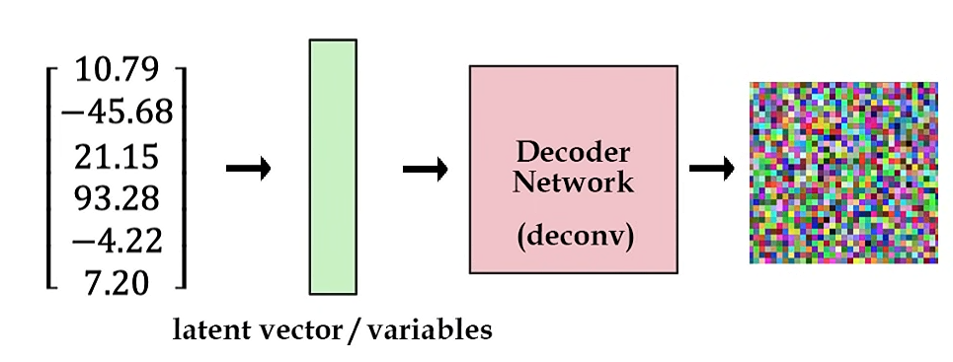
Autoencoder
x
x̂
Minimize the reconstruction loss i.e. min|x-x̂|
Some random vector embedding

Slide 4
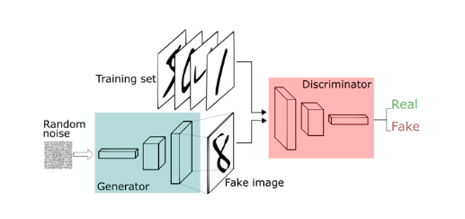
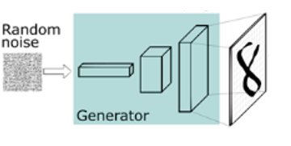
GAN

Slide 5
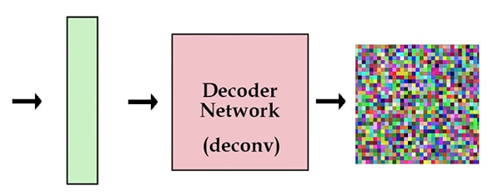
Variational Autoencoder (VAE)
Objective
Develop an autoencoder that can generate image
Dog images pool
Horse Images pool
Global pool
Cat images pool
Zebra images pool

Slide 6
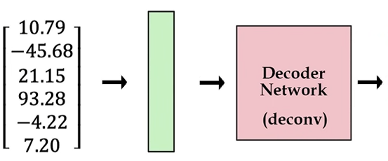
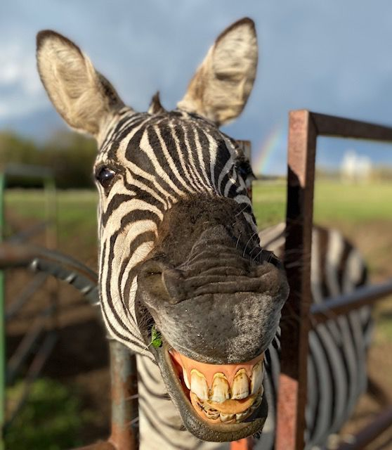
Variational Autoencoder (VAE)
Define a pool of interest
Always draw samples from this pool
Global pool
Continuous pool
ROI

Slide 7
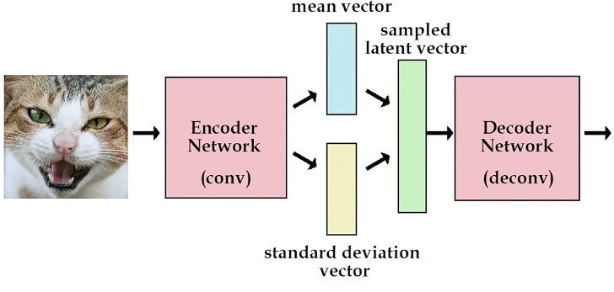
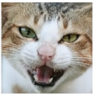
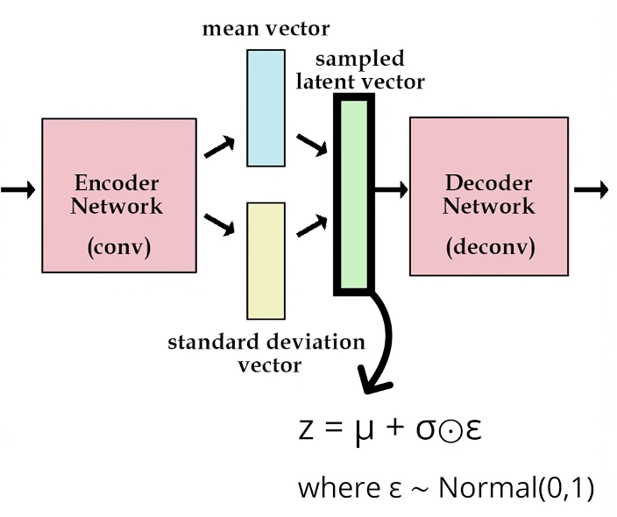
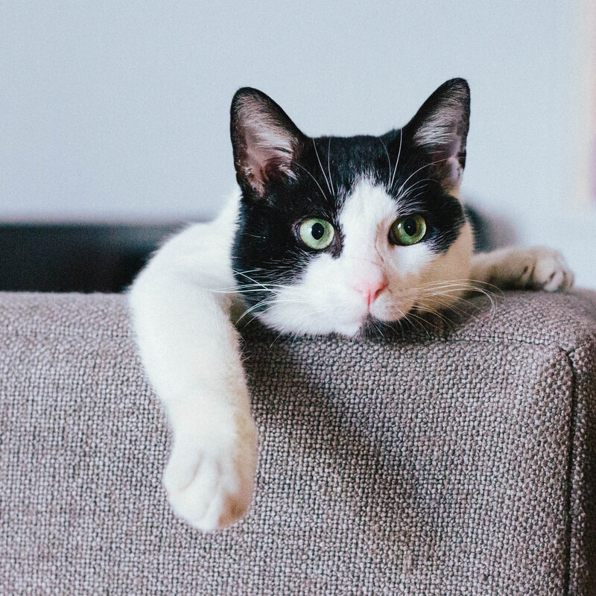
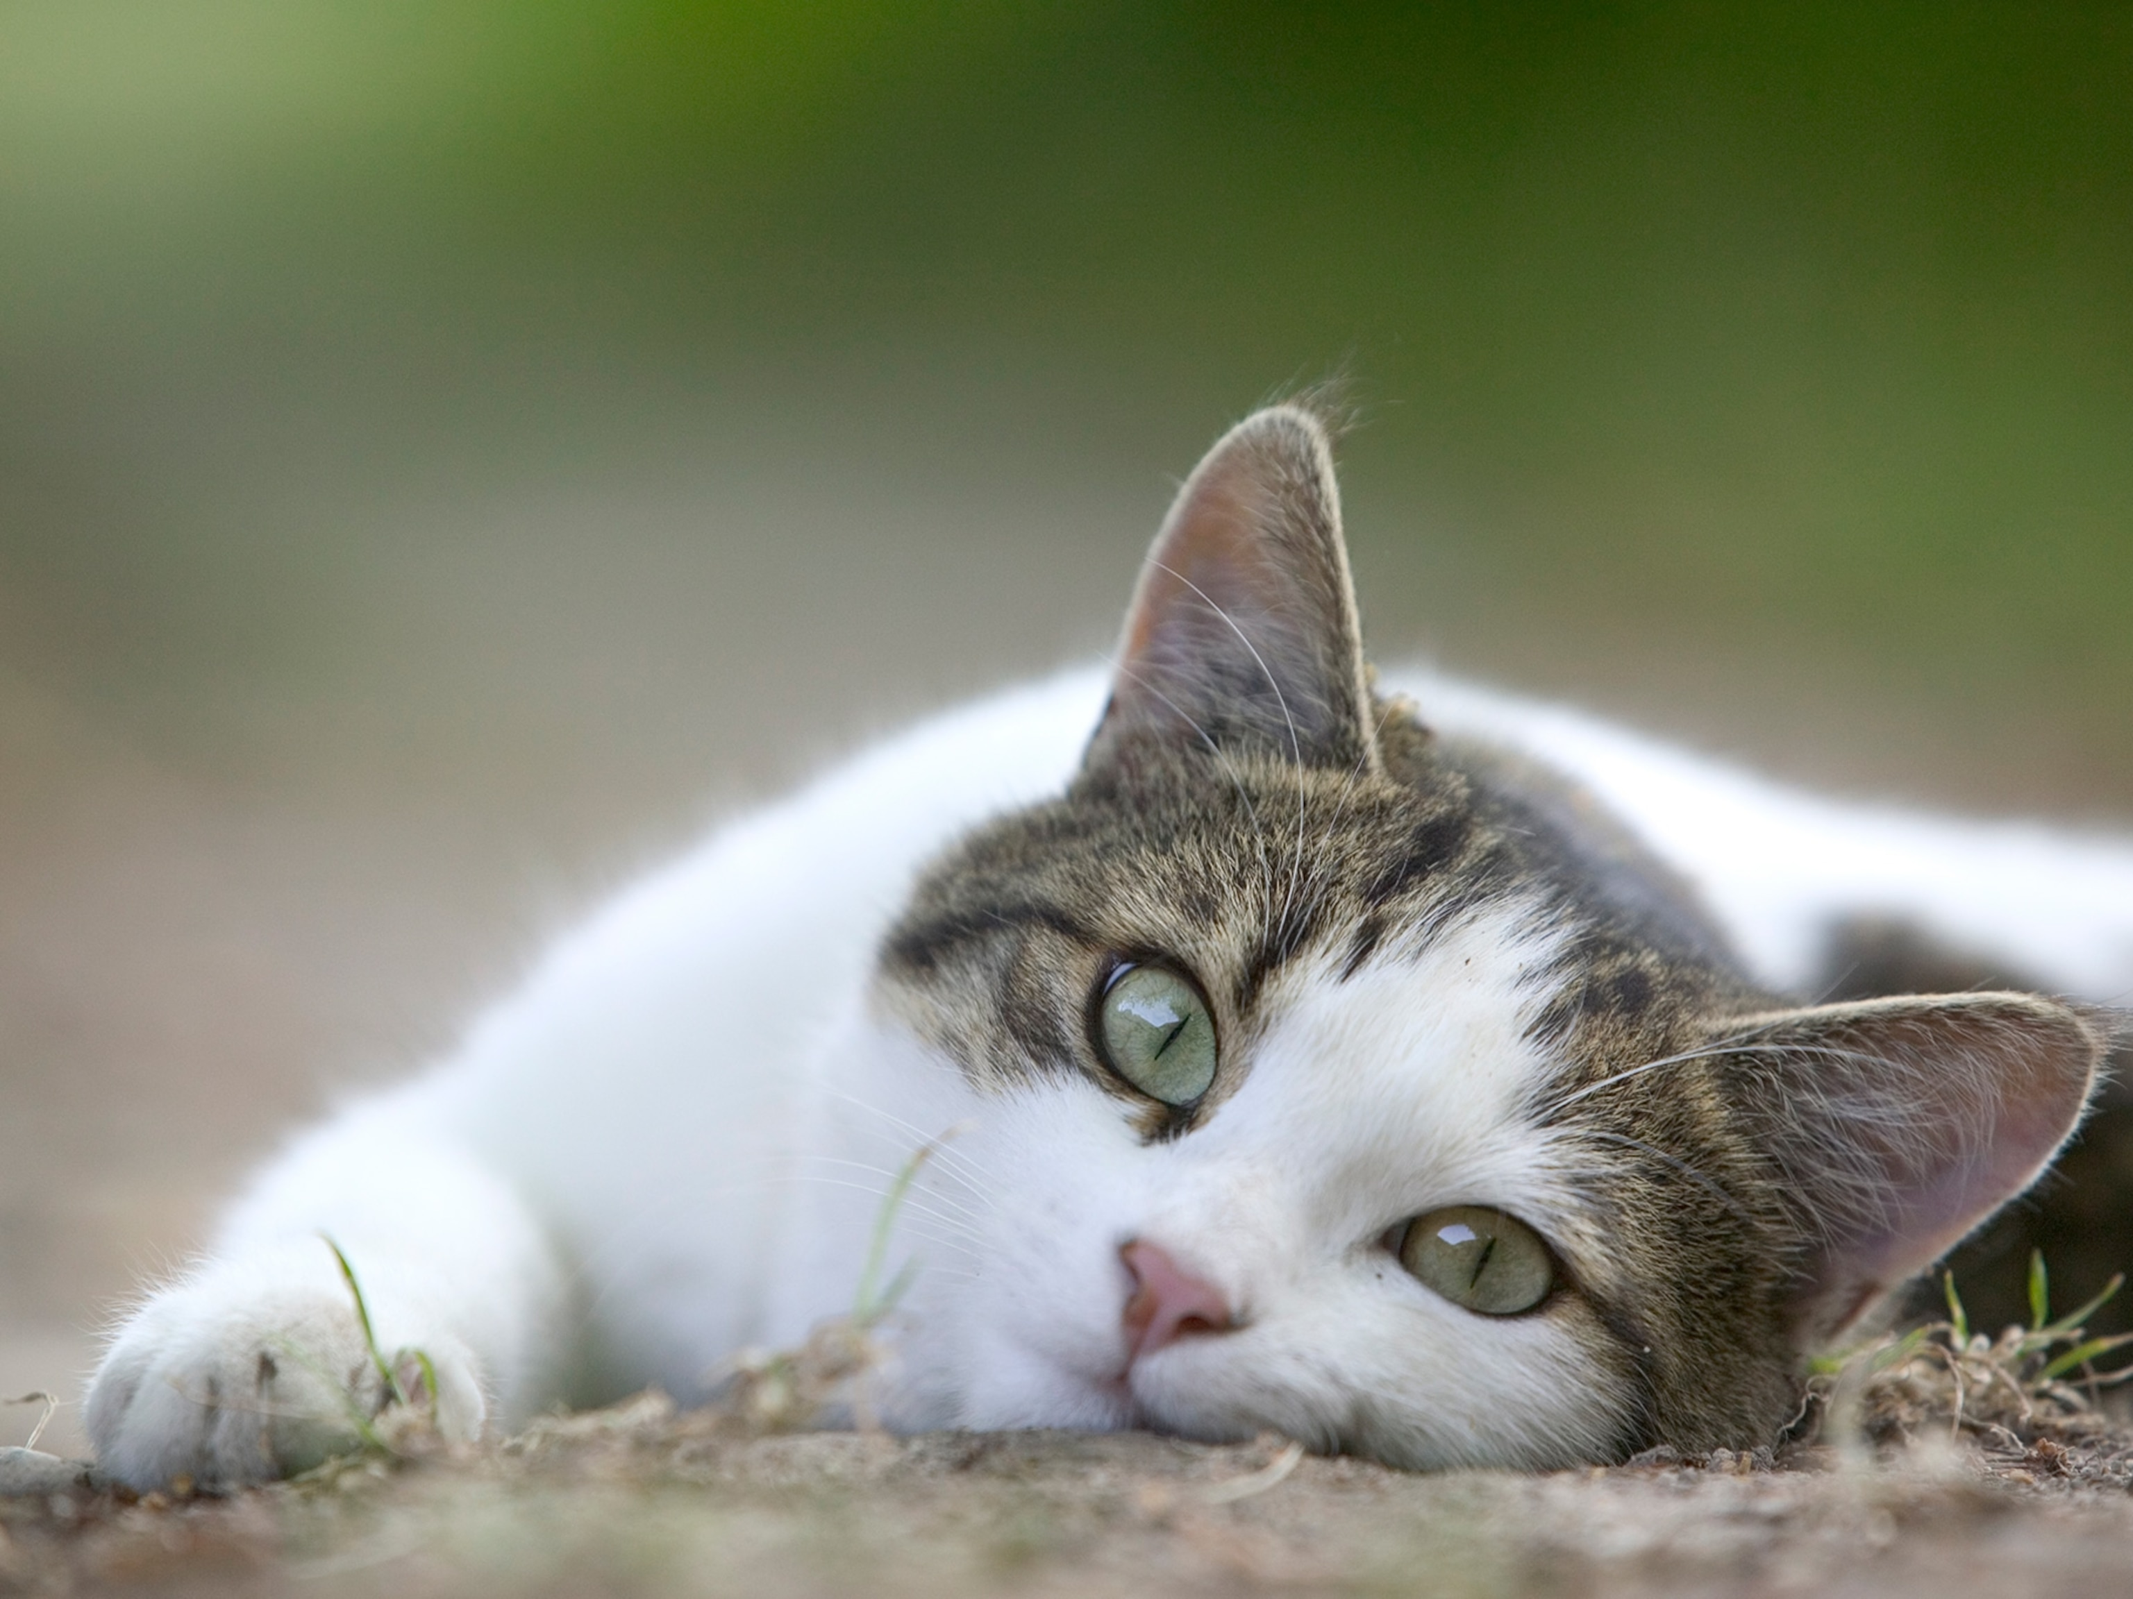
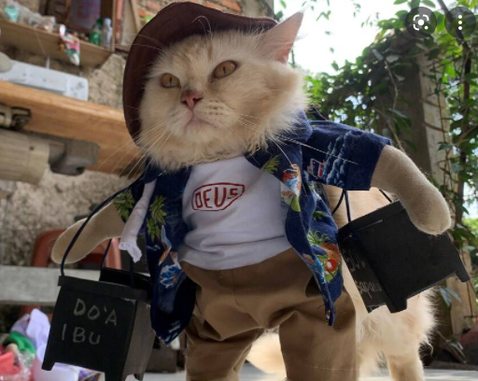
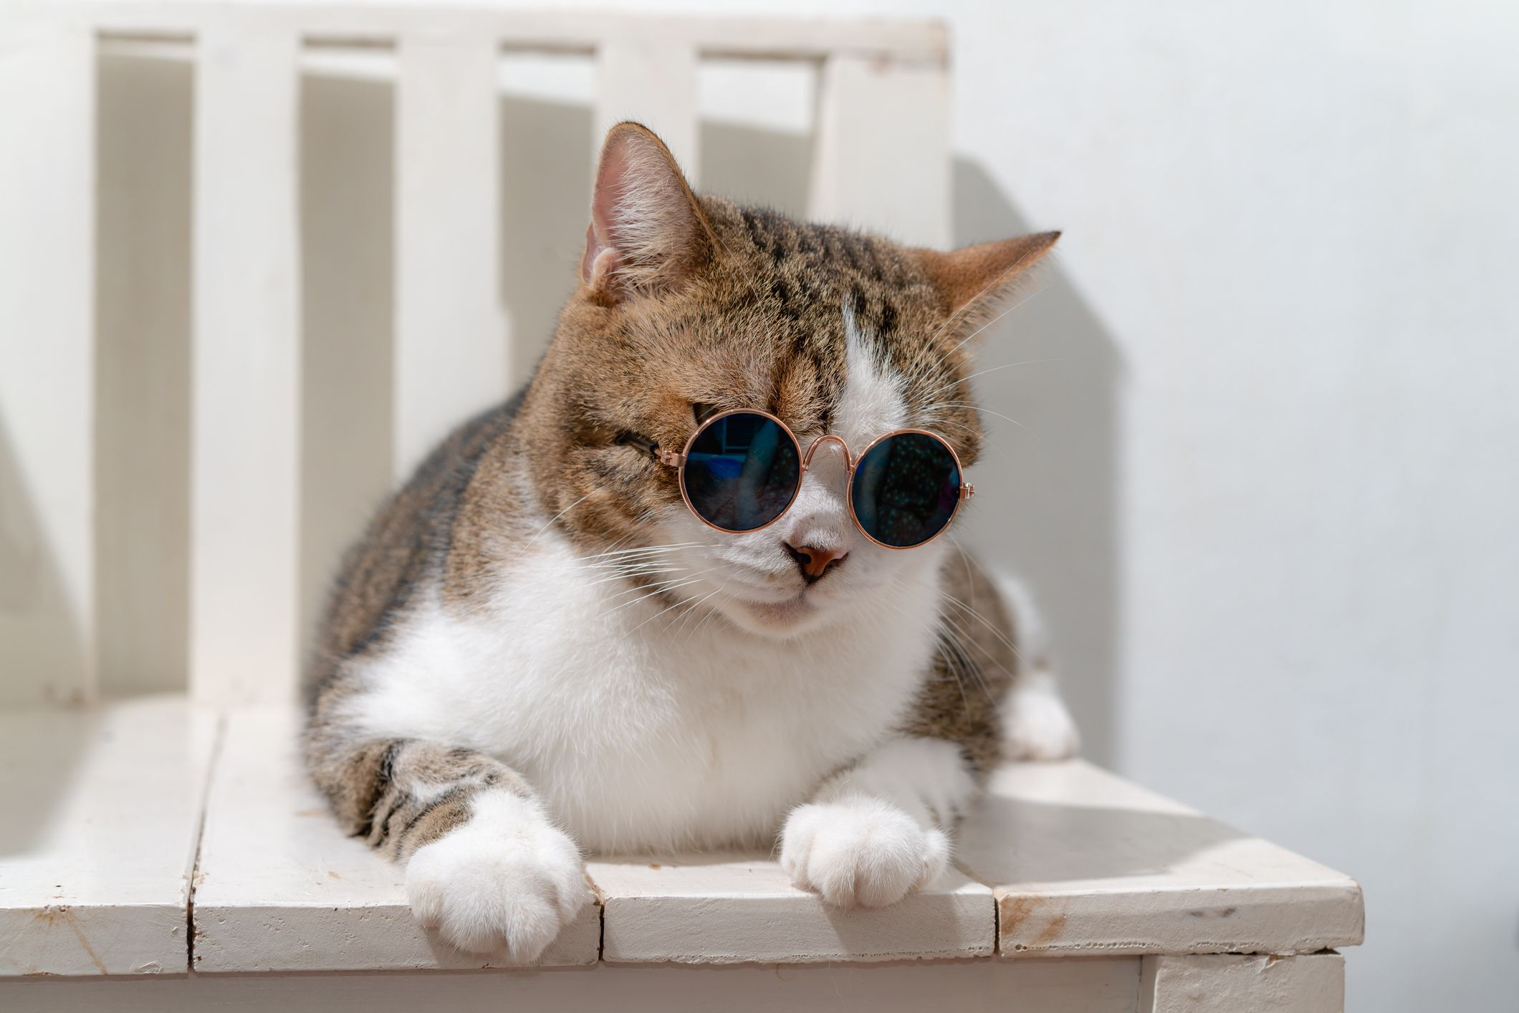
Variational Autoencoder (VAE)
Use mean (µ) and standard deviation (σ) to sample
Yet draw samples from this pool
µ
σ

Slide 8
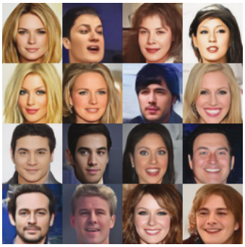
Variational Autoencoder (VAE)
Optimization function
latent loss
reconstruction loss

Slide 9
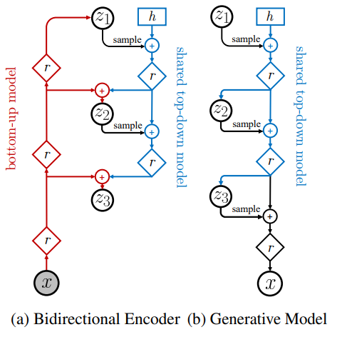
Nouveau Variational Autoencoder (NVAE)
ResNet
Batch Normalization
Swish Activation
Temperature change
NVIDIA APEX library

Slide 10
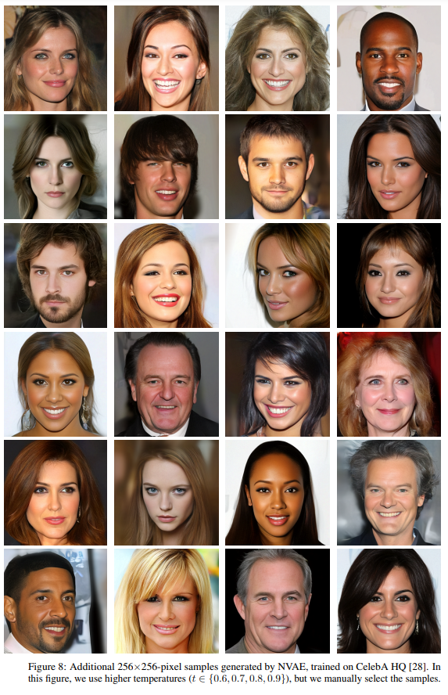
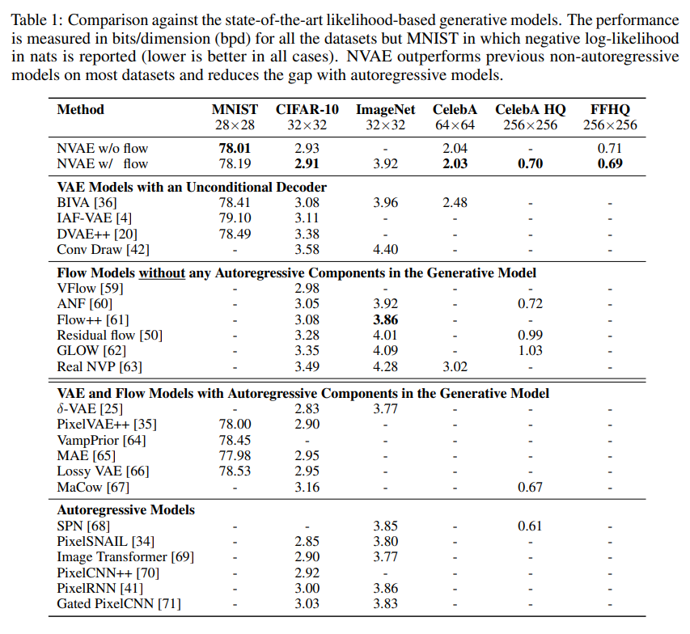
Results

