Slide 1
SchemAgent: Multi-Agent VLM Framework for Connectivity Extraction from Nuclear Plant Diagrams
Asiful Arefeen

Slide 2

About Me
Asiful Arefeen
C220: Risk and Reliability Research
Mentor: Andrei Gribok
PhD Candidate in Biomedical Data Science at the Arizona State University
Research Interest
Explainable AI
Timeseries Forecasting
Trustworthy AI
Cost-effective foundation model training
Multi-agent system development
Information Retrieval

Slide 3
Objective
Develop an automated framework to convert nuclear power plant electrical schematics into structured component-to-component connectivity matrices.
Integrate multi-modal schematic information, including raw diagrams, detected components, OCR labels, wire traces, junctions and node layouts, to support reliable connectivity inference.
Use a multi-agent VLM workflow that combines high-recall connectivity extraction with precision-oriented review to reduce missed connections and unsupported edges.
Generate traceable digital connectivity data that can support engineering impact assessment, fault-path tracing, dependency analysis, configuration management and plant modernization.

Slide 4
Significance
Transforms legacy drawings into usable data: structured, machine-readable connectivity matrices
Reduces manual engineering effort: slow and repetitive tracing of component-to-component connections
Improves consistency and reduces human errors stemming from overlapping wires, junctions, labels and non-uniform drafting styles
Supports faster fault and impact analysis, quick identification of connected components, downstream dependencies, possible fault paths and downstream technology design

Slide 5
Significance
Connectivity graph or matrix can support digital twin development, dependency modeling, automated reasoning, maintenance planning and operational decision-support tools
Using ChatGPT or GPT 5.5 on the raw diagrams implies poor extraction performance

Slide 6
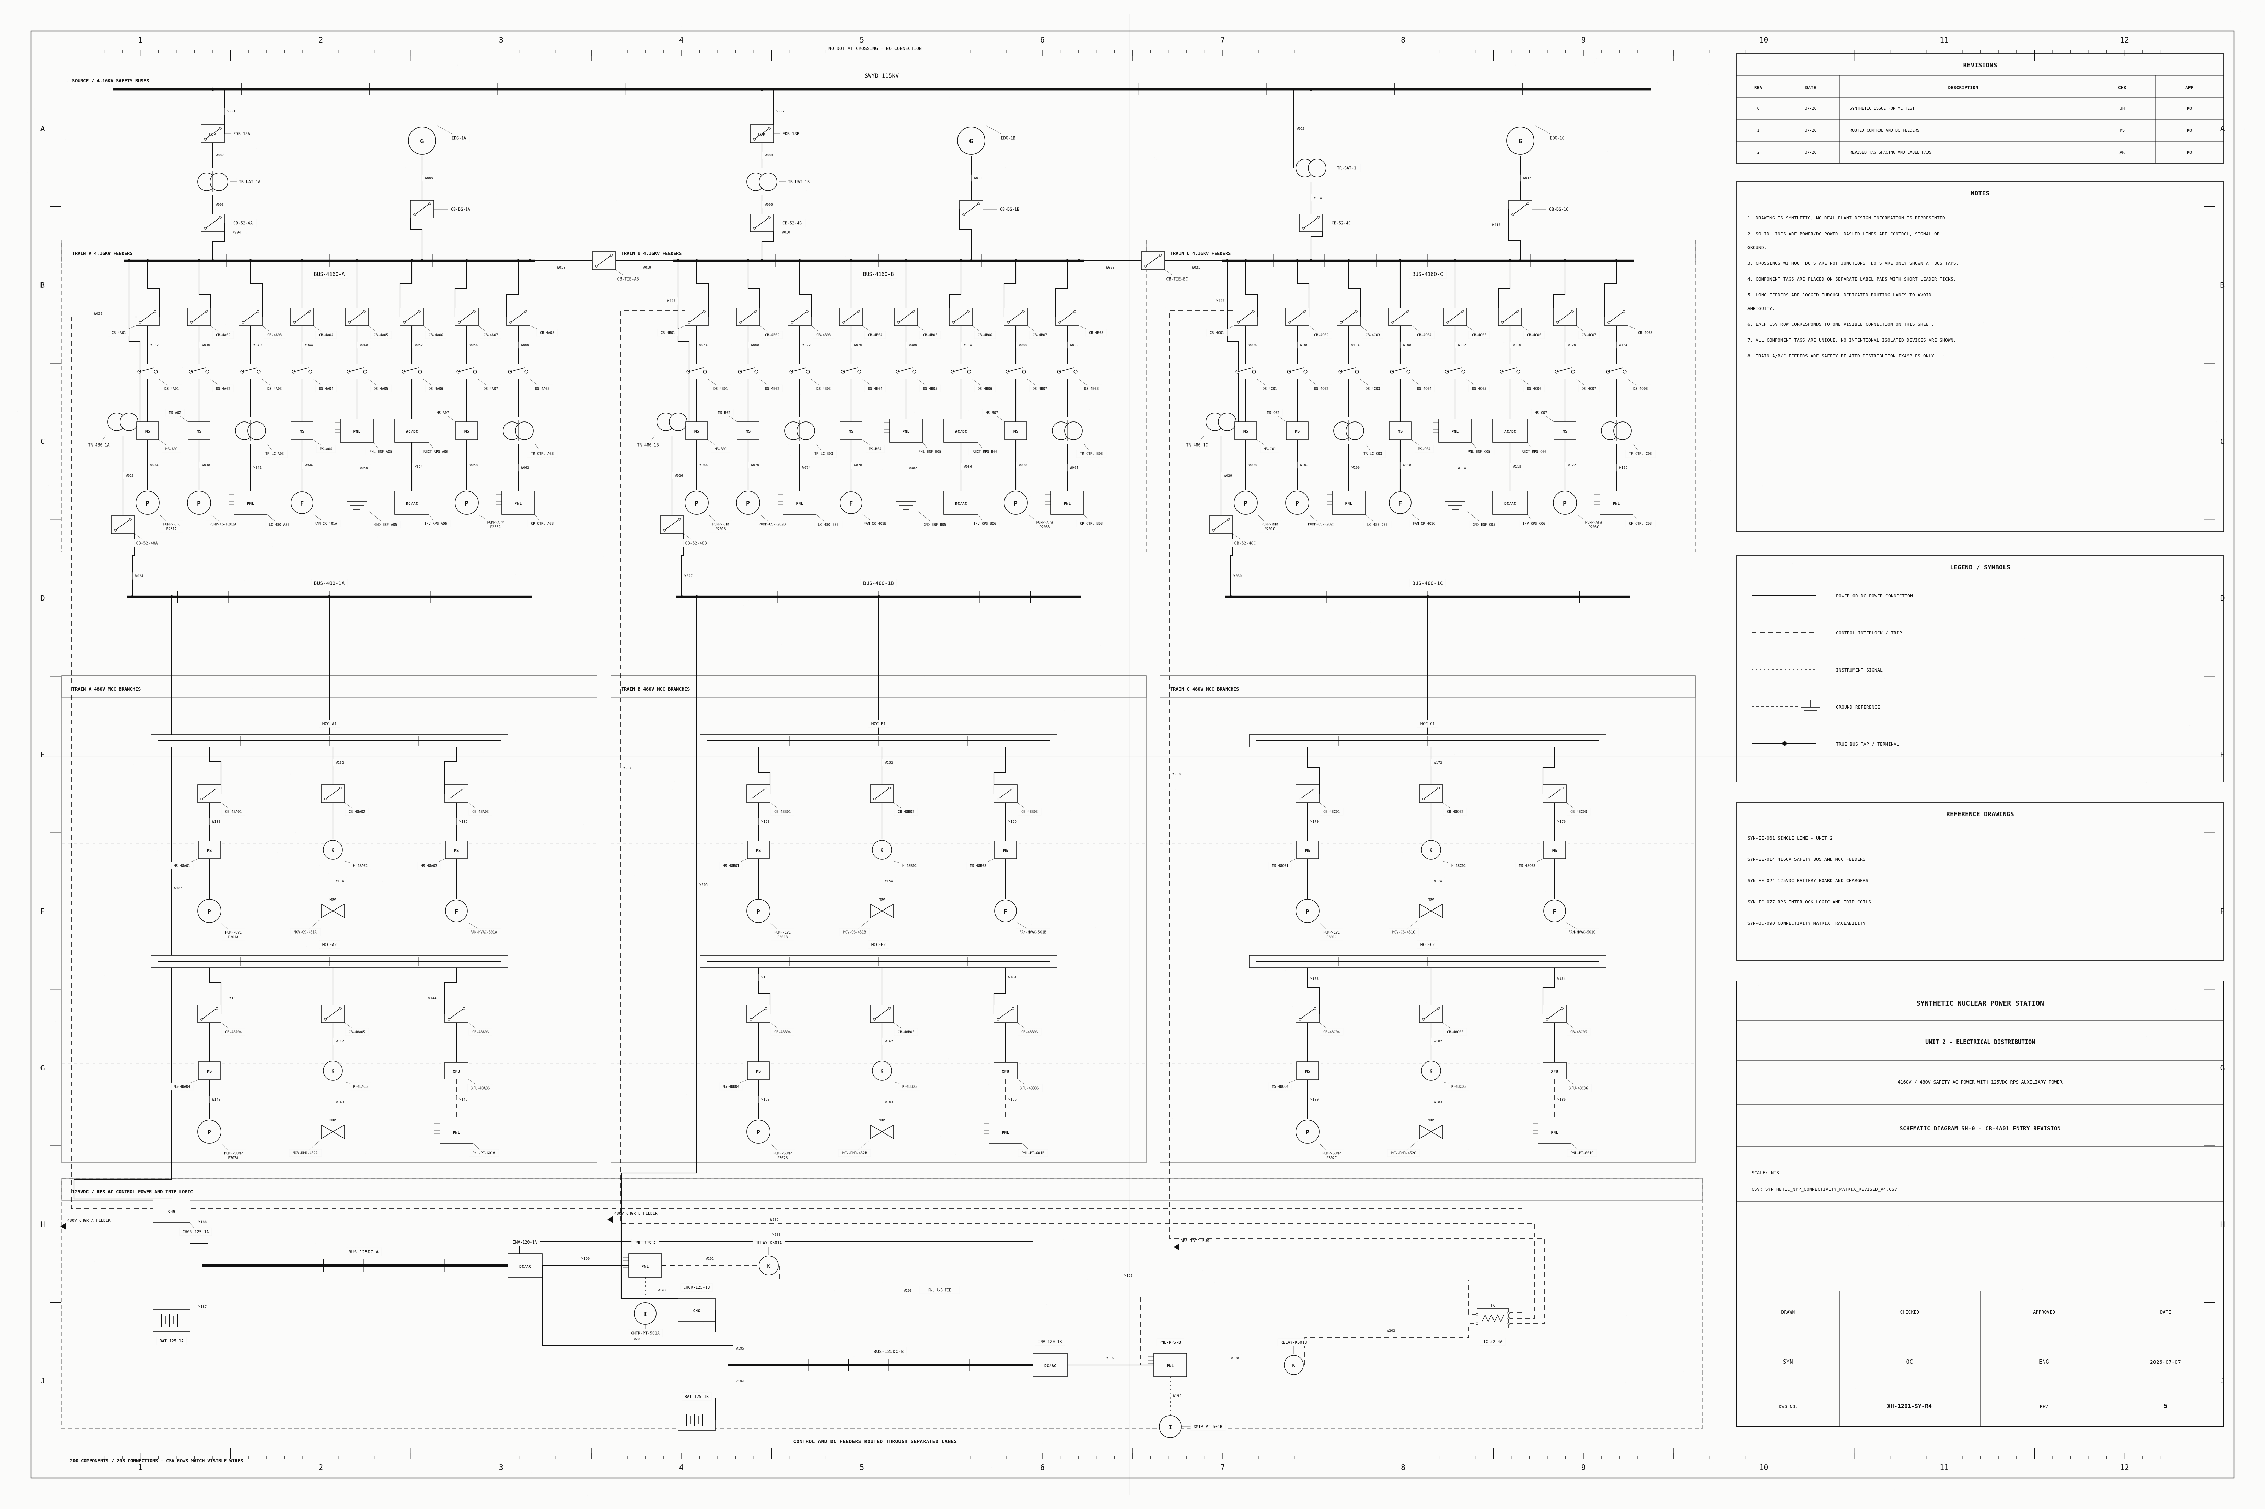
Method
Layer Generation
Raw schematic diagrams containing components and overlapping connections

Slide 7
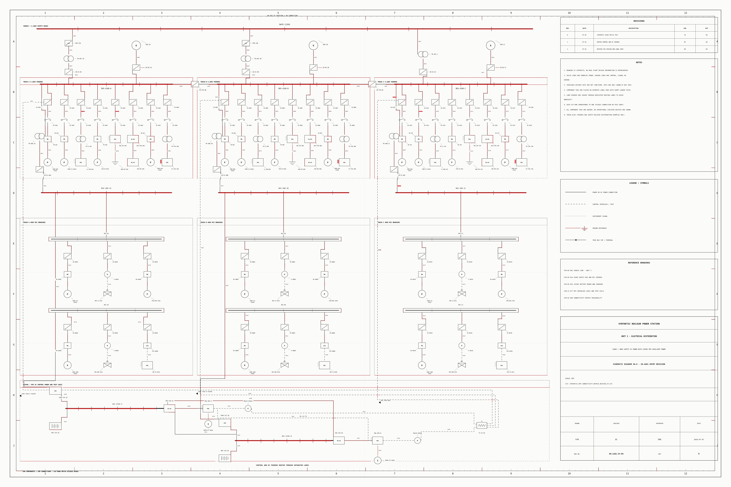
Method
Layer Generation
Wires detected and marked using standard computer vision methods

Slide 8
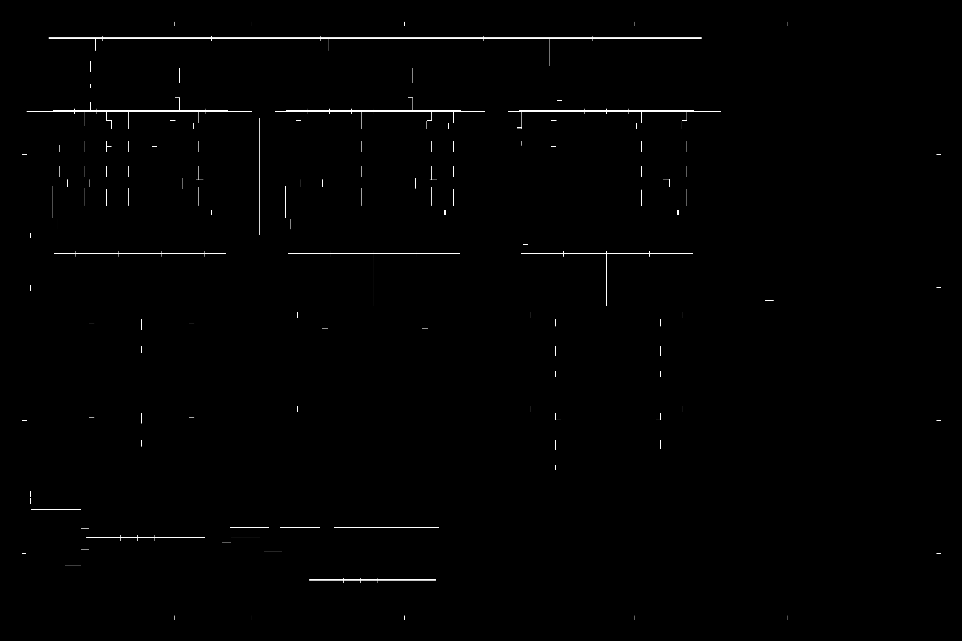
Method
Layer Generation
Wires detected and marked using standard computer vision methods

Slide 9
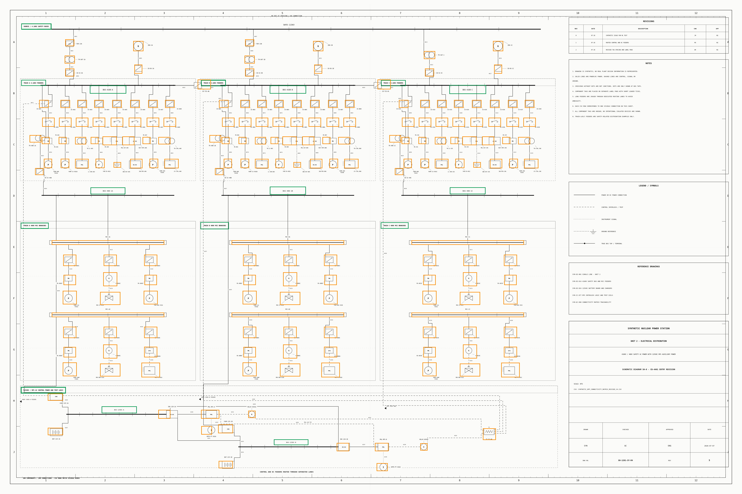
Method
Layer Generation
Components detected and marked with bounding boxes using an AI agent

Slide 10
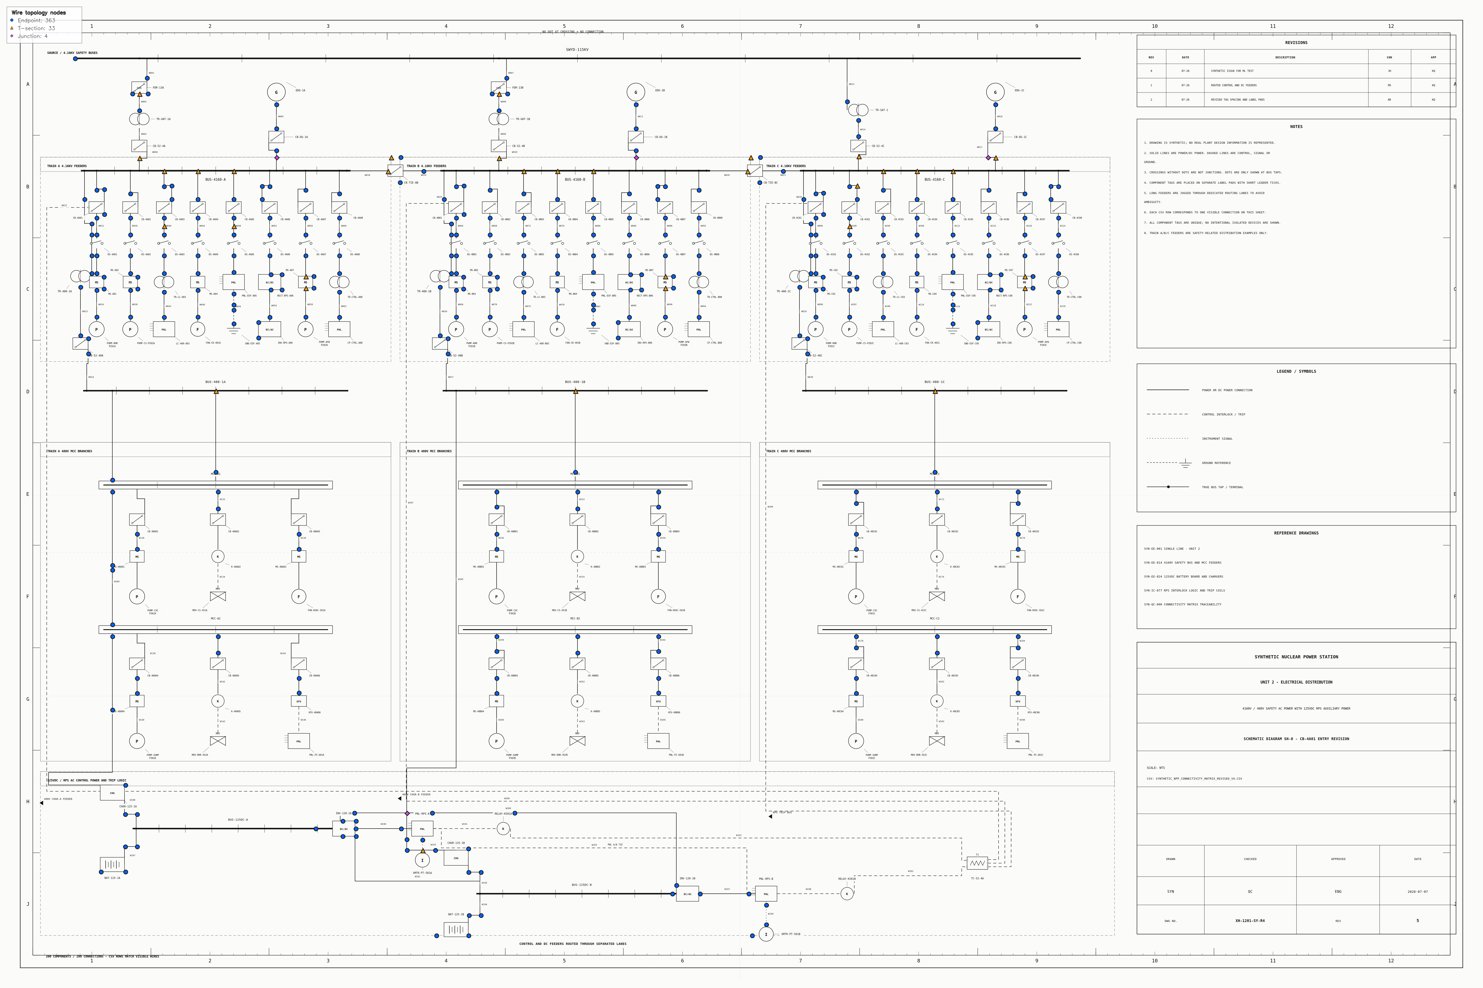
Method
Layer Generation
Nodes and junctions detected and marked using standard computer vision methods

Slide 11
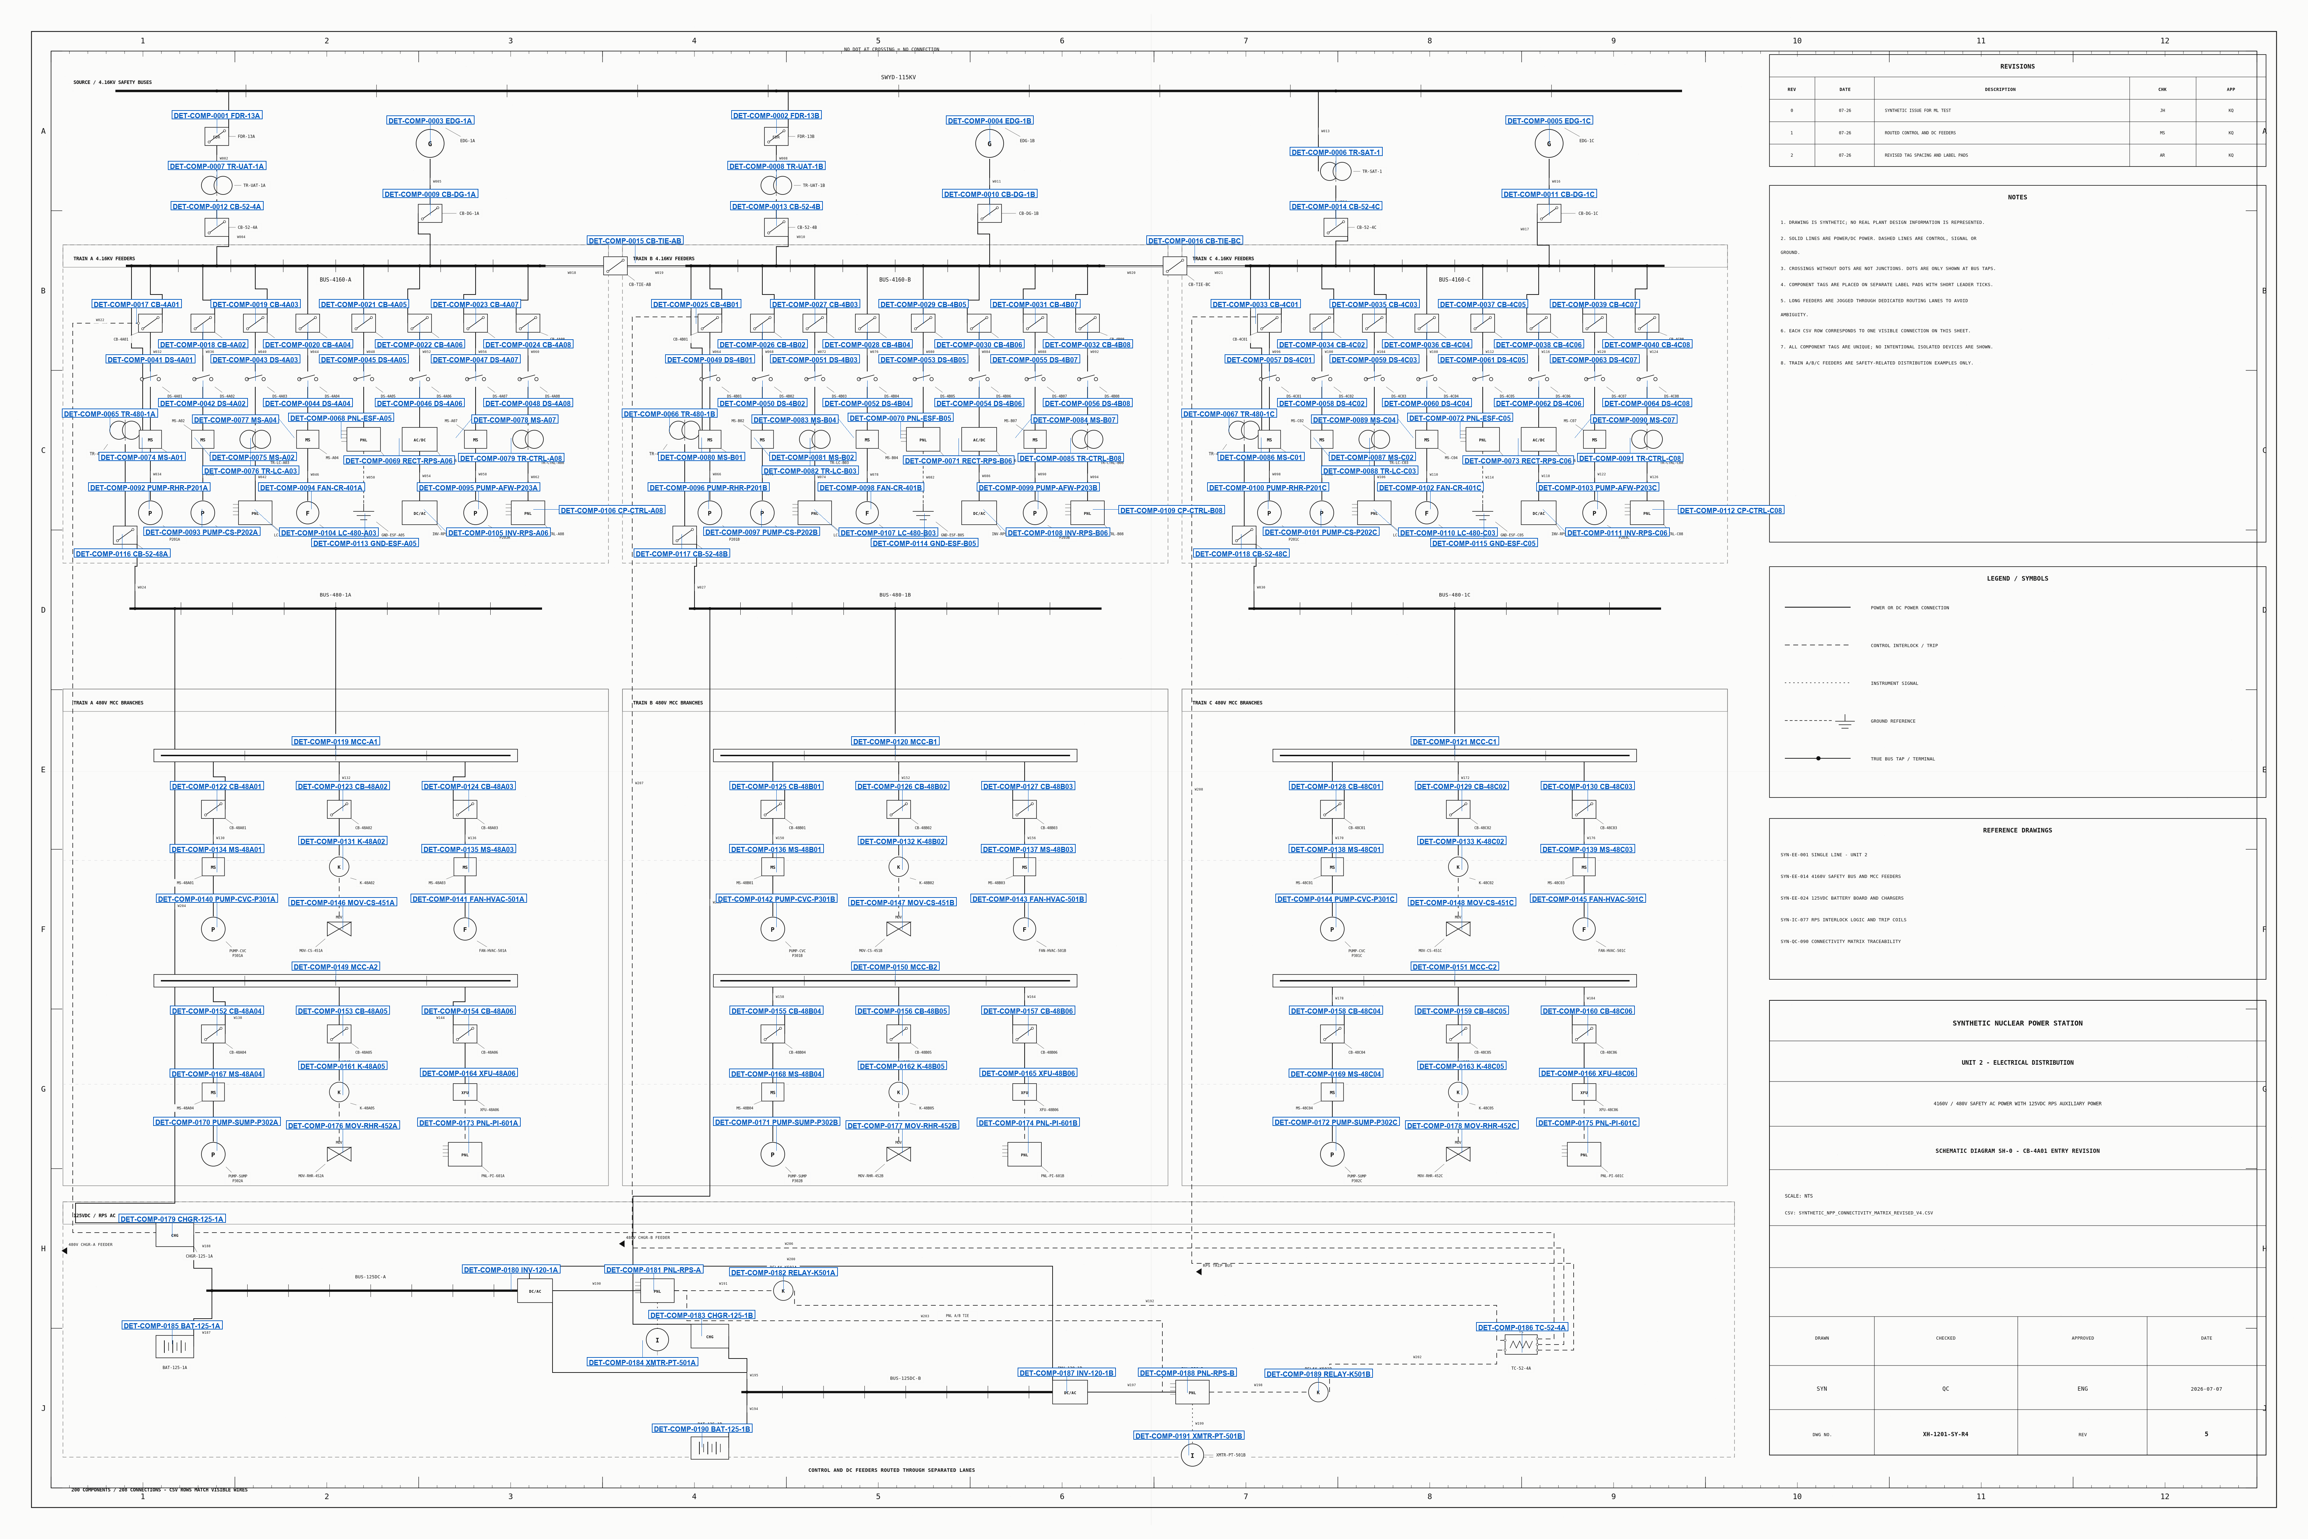
Method
Layer Generation
Component tags detected and marked with bounding boxes using an AI agent

Slide 12
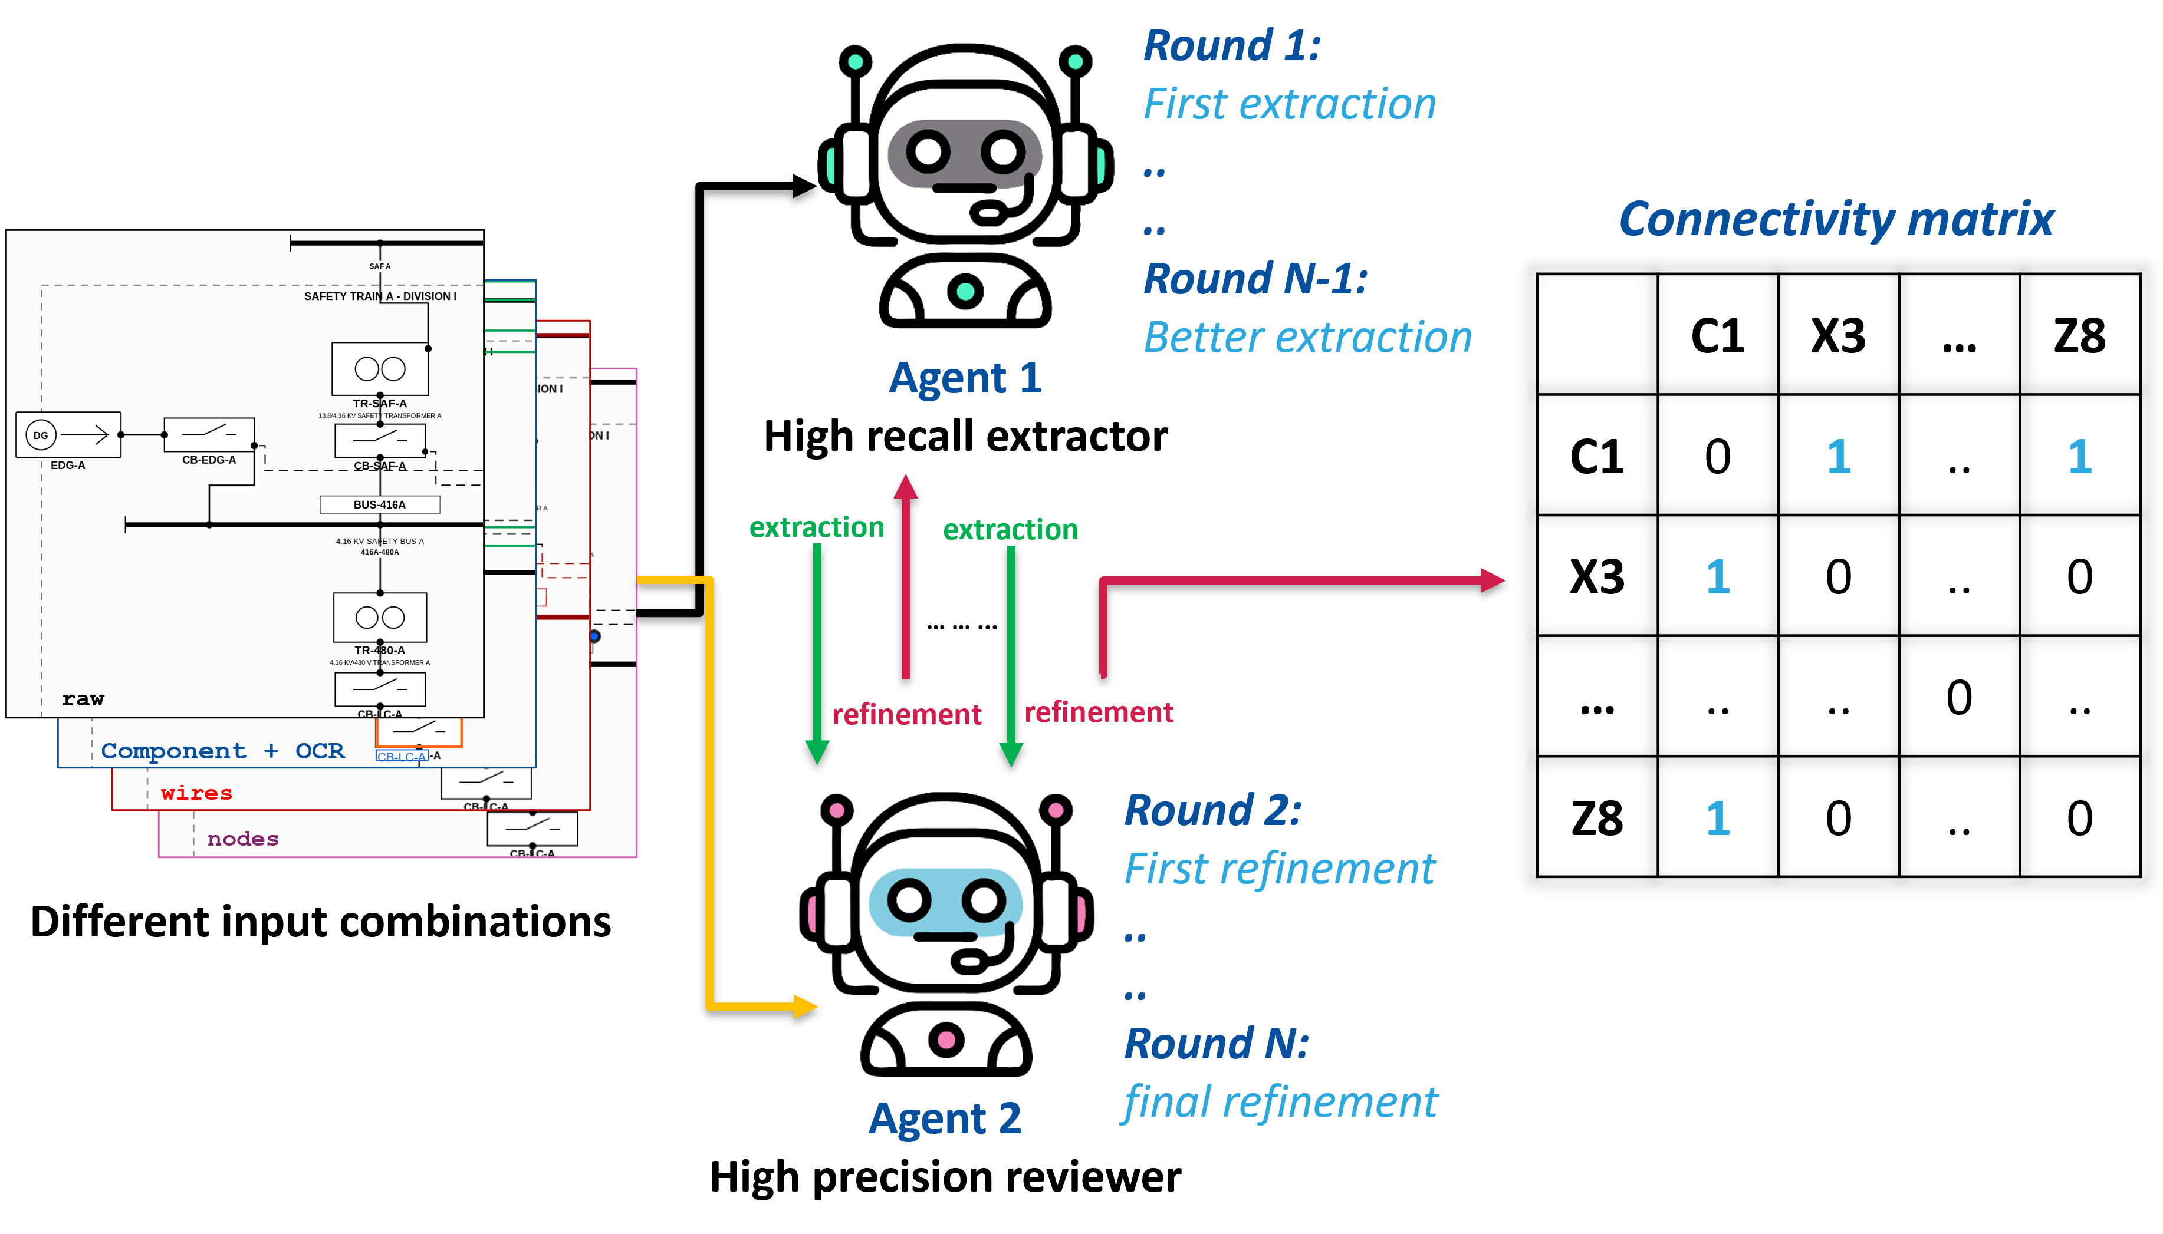
Method
Multi-agent framework

Slide 13
Data
Synthetic
Synthetic diagrams are generated with few shot prompting
GPT 5.5 was used to generate diagrams along with the ground-truth connectivity matrix
Diagrams contain 50-200 components and almost same number of connections. Most diagrams contain components and connections between 100 and 200
Generation was guided by supervision to prevent unrealistic wire cluttering and component/tag overlaps
Generated diagrams were distributionally/semantically meaningful

Slide 14
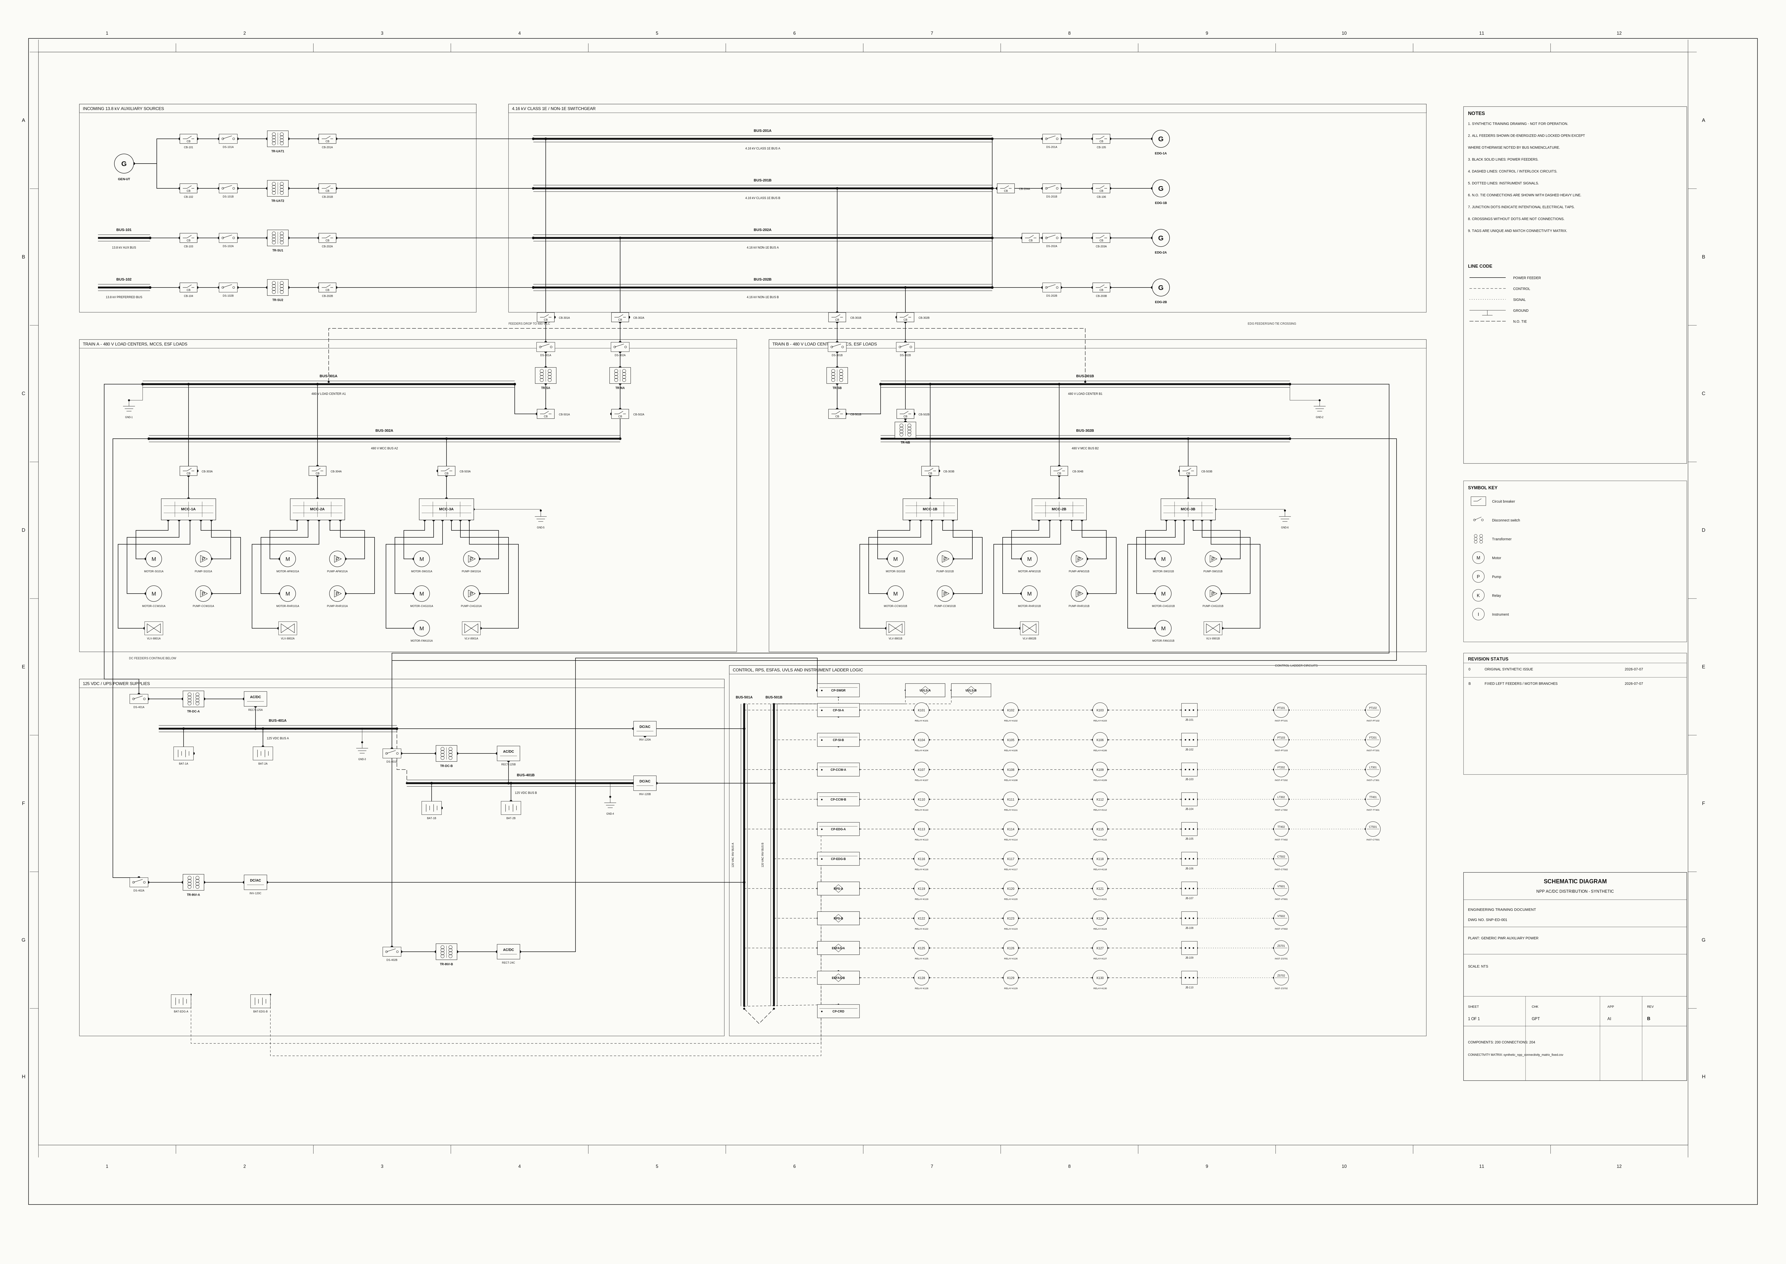
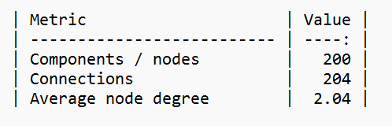
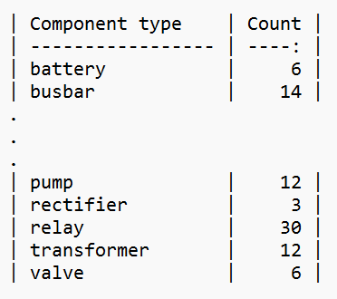
Data
Synthetic
Example of a synthetic diagrams and stats

Slide 15
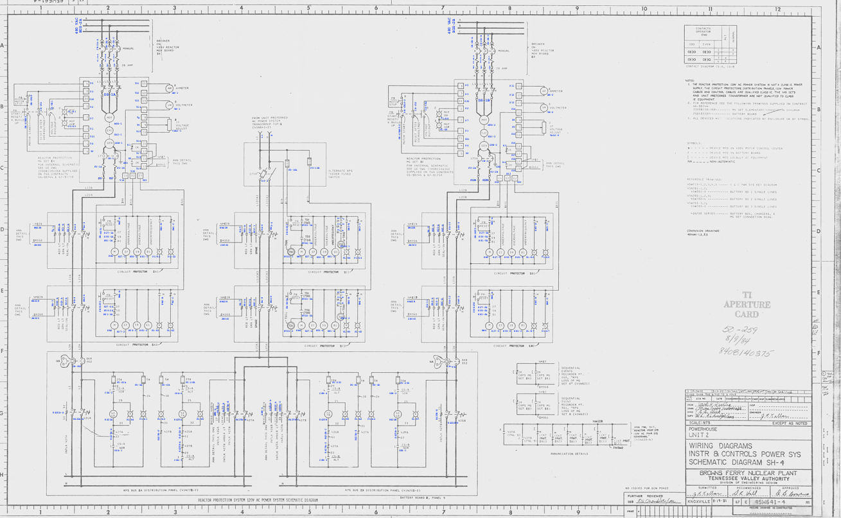
Data
Real
Collected from NRC
(US Nuclear Regulatory
Commission) database
Partially human labeled
Ground truth connectivity matrix
derived

Slide 16
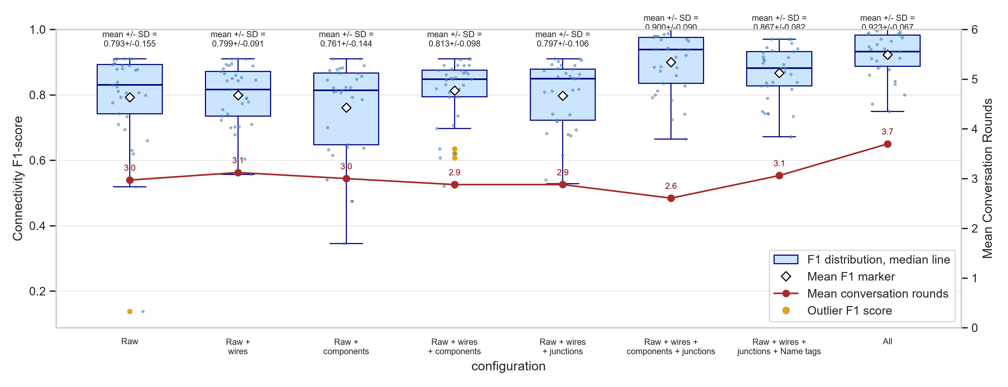
Results
Comparison among input configurations

Slide 17
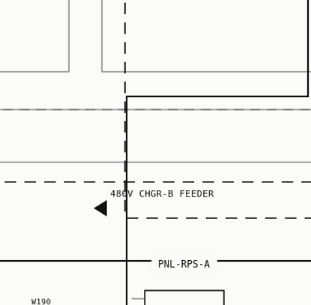
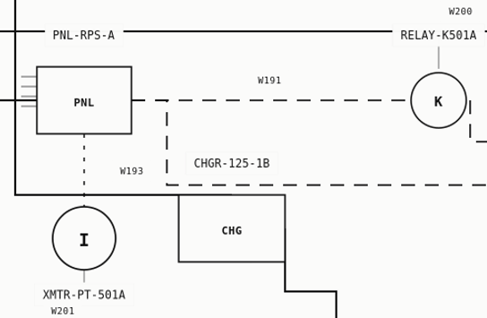
Results
Where it struggles?
Confusing/unrealistic overlaps
Cluttered wires

Slide 18
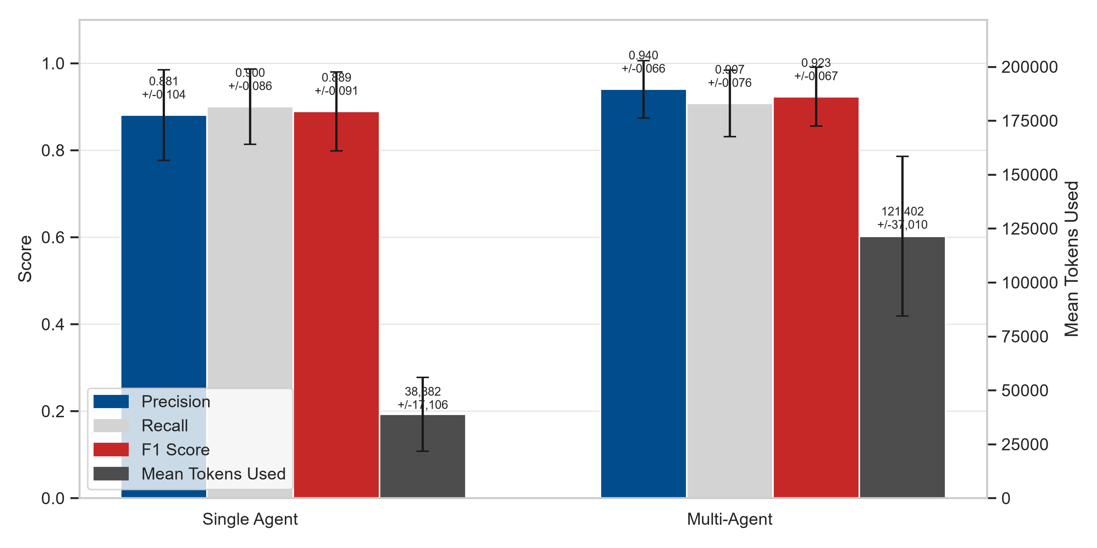
Results
Single vs. multi-agent performance

Slide 19
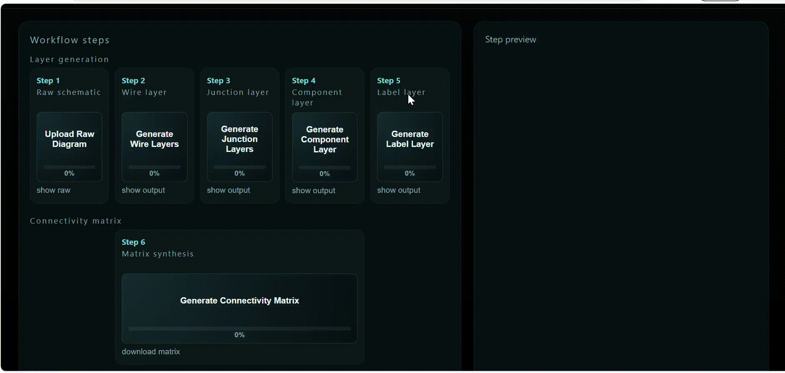
Results
Interactive dashboard

Slide 20
Limitations
Multi-agent systems are high consumers of token. A confidence-based thresholding in each step of the extractions can reduce the token consumption
Some highly complex real diagrams have been excluded. They can be excessively challenging to label by human and extract by AI agents

Slide 21
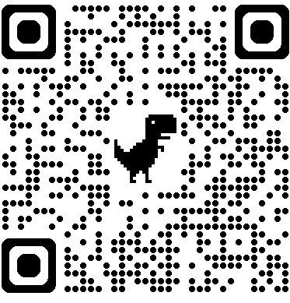
Thank you
Questions?
asiful-arefeen.com
www.inl.gov

